Slide 1
Are we making the change we want? How do we know? How do we show?
INFORMATION IS POWER
Dr Marion Norton
Brentyn Parkin
March 2014

Slide 2
The evaluation checklist
Know the change we want to see
What does it look like when it works?
Know what we are doing to get there
What are the features of our intervention?
Know what data we need and where to get it
Make the most of data around you
Include observed change of behaviour and what people think
Notes:
Focus for today
Mostly we will talk about number 3

Slide 3
The change we want to see
Problem - vulnerable people can’t get legal advice when they need it.
Solution - “equitable access to the legal system and justice, and the equal protection of human rights” (NACLC)
If it works well,
Vulnerable people in our community get justice - get heard, understand the case against them and reason for decisions, and can make informed decisions.
Where does change stop and start?
Notes:
Underpinning belief that lack of legal representation breeches social justice, human rights
Tell a story about the change you saw in a client - in last month
(pick 2)
Is legal service an end in itself – or a means to an end (eg food, shelter, employment)

Slide 4
Where does it start and stop?
A = gets a fair go
B = gets justice (heard, equal access, make informed decisions)
C = gets a fair legal outcome
D = avoids a bigger legal problem
E = has reduced impact on their wellbeing (costs, penalties, access to food, shelter, family and friends)

Slide 5
What are we doing to get there?
access to free legal advice, information and assistance
systems advocacy
increasing community awareness of the law
plain-English publications
working to change unfair laws.
Features
which is professional, non-discriminatory and timely
People with disability must positively and actively be accorded worth, dignity, meaning and purpose through being included in and with their community
Notes:
This is the intervention – or our service

Slide 6
Measuring activity
Activity Profile for CLCs in 2012/13
total number of clients assisted: 211,896
total advices provided: 248,970
total active cases: 76,142
cases opened: 51,773
cases closed: 51,220
What else do we want to know about the services?
- did we get the right clients
did we provide the right advice
did we provide enough service

Slide 7
Program logic
Fair and just society
Vulnerable people get heard, equal access, make decisions
Quality legal information and support for vulnerable people
Sound business systems and processes
Notes:
Org level - up and down
Individual level using examples

Slide 8
Step 1: Identify the data you have internally
Know what data we need and where to get it
Subject of the data
Items in the data
Storage/ form of the data
Use of the data
Quality of the data
Notes:
We often complain that we don’t have any data – and we see it as a huge cost to get. We envisage the grand database that will do everything.
But under our noses there are sources of data that are potentially very valuable, and may just need a small adjustment to be extremely valuable.
Activity: Work in pairs or individually. 5 minutes to think about internal data sets that could be used.

Slide 9
Step 2: Improve your data quality
Consistency: definitions of terms, standards, training, built-in protocols
Currency: up-to-date, validated
Accuracy: verified - reported back to owners
Linked to critical consequences:
eg payroll, bonuses
Notes:
Don’t wait for your data to be perfect. Using it will increase its value and will make people want to get it to be accurate.

Slide 10
Step 3: Make the most out of operational data
A case study: Service linker
The challenge: to stop clients repeating programs
no staff time to enter data
clients with limited literacy
need for privacy
OHS requirement to know who is onsite – various types of venues
Notes:
1 min

Slide 11
Service Linker: Data collected and shared
Statistical linkage key (unique identifier)
Date and time
Post code
Program attended
Organisation name
What information can we gather from the data?
Notes:
2 mins (show excel spreadsheet)

Slide 12
Primary purpose of the data: Client
Which programs has XX attended?
Has s/he attended regularly – the whole course?
SO
a. What does the client need to do next to be work ready most efficiently?
OR
b. Does limited attendance need to be addressed?
Notes:
Who wants to know? (2 mins)
Case worker
next agency he goes to

Slide 13
Secondary purpose: Program
Patterns of program attendance –
- frequency by day/ time
- duration of attendance in a program
- age, gender attending
- distance travelled
Who is the program attracting or retaining?
Are we getting the whole target group?
Notes:
Who wants to know this? (2 mins)
Program manager
Centre manager
Funder

Slide 14
Secondary purpose: Organisation
How many people have attended/ completed each employment program?
Which programs are more popular?
Comparisons by time (quarter)
Comparisons by demographics
Efficiency: Cost per throughput by client factors
Link to other client data eg employment record in case file
Longitudinal data on a sample of clients
Notes:
Who wants to know? (2 mins)
Centre manager – allocation of resources across seasons; report to funders; determine efficiency
Evaluator – link program attendance with outcome.
Go back to table 1 – what extra value could data be? (5 mins)

Slide 15
Step 4 – Visualize your data
a. The client
Convert client addresses to Google maps.
Find out:
How far does your client have to walk?
How close is the bus or train?
What services are close by?
Notes:
Show spreadsheet results – discuss anomalies of distance – new questions

Slide 16
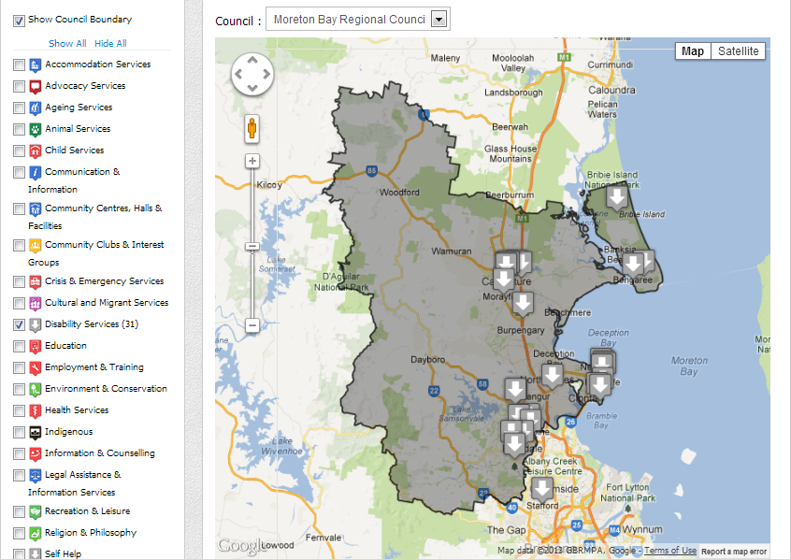
b. Your sector
My Community Directory
Notes:
Show legal centres in a region

Slide 17
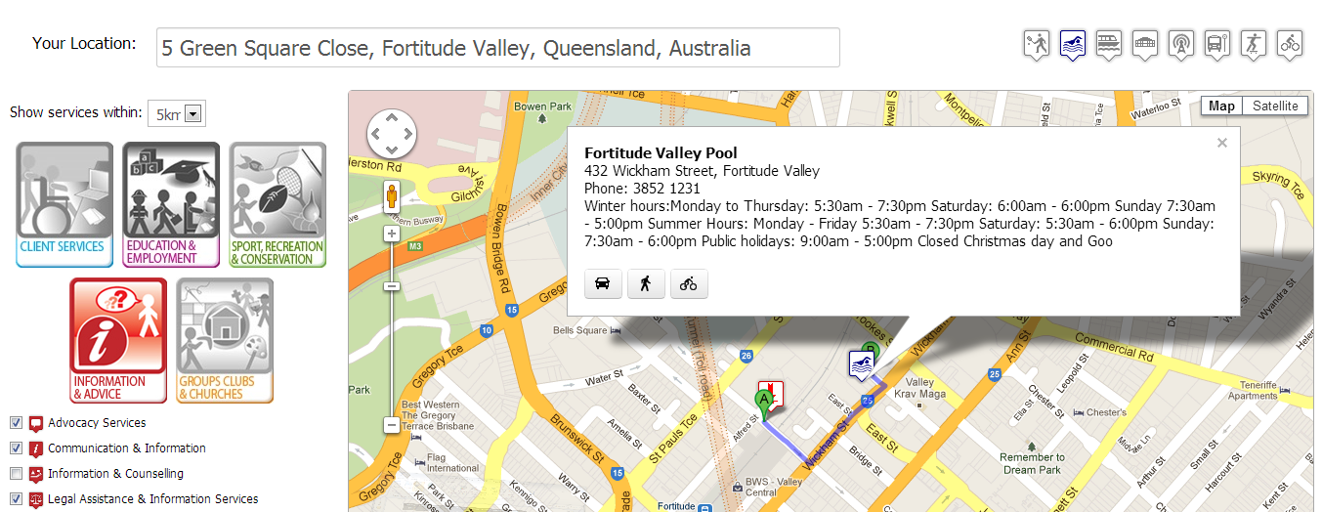
c. Links to other services
Open Data
Open Data (Brisbane City Council) My Community Directory & Westside Community Services
Notes:
Show legal centres – and employment, centrelink - Ask them – what else would you want to know?

Slide 18
Step 5: Use external data
http://www.justice.qld.gov.au/justice-services/victims-of-crime/information-for-agencies/research-and-statistics
Office of Economic and Statistical Research (Qld state government)
COMSIS
ABS census data online http://www.abs.gov.au/census
ABS reports – release notifications
Labour Market Information Portal http://lmip.gov.au/
Registers eg ASIC, Business registers
Annual reports, budget papers
Open data https://data.qld.gov.au/department-strategies
Specialist newsletters eg ProBono, ARACY
My Community Directory – Community Information Support Service

Slide 19
Take care with external data
Data needs analysis to make it useable information
Pay attention to the data definitions, scope, sample size
Test the aggregate assumptions on the ground
eg number of vulnerable people - but how many people actually need assistance in an emergency

Slide 20
Step 6: Gather the missing data
Inputs √ ($, time, staff, space)
Throughputs √ (client activity)
Outputs √ (drop-outs, closures)
But – how do we know if the service is doing what it is mean to?
What is our social impact?
We need “evidence”:
Change in client behaviour
Opinions of informed observers and participants

Slide 21
Change in behaviour
Vulnerable people get heard, have equal access, make decisions
What does this look like?
Notes:
Emphasise that we want to be able to OBSERVE this behaviour - before and after. It is not perception.
Can be measured with pre and post surveys of actions or beliefs.

Slide 22
Other impacts of legal help
Financial
Housing, health
Relationships, connections, belonging
Safety, security
Freedom
Reputation, self-worth, being believed
Inclusion
Use checklists, case studies
Notes:
It will probably be info in case files. How can you turn data into information?

Slide 23
Gather opinions
What changes do people report
- was the person heard?
- did they have equal access?
- did they make informed decisions
What changes do people attribute to the service?
Notes:
This is more than satisfaction with the service
It includes client and those around the client eg family, professionals/ practitioners. What do they think has been the benefit?

Slide 24
Also need to know
Did we deliver the service according to our intended quality?
What were the features when it:
Worked well
Didn’t work well
Did the systems and processes support the delivery of a quality service?
Notes:
Features – client features, service or practitioner features, context features.

Slide 25
Summary
Know what the outcome should look like
Know what service you are providing to get there
Use available data and fill in the gaps

Slide 26
Tools
www.communityinfo.org.au

